Slide 1
LEAN MANAGEMENT IN HEALTHCARE REDUCING WASTE & IMPROVING SPACE UTILISATION
ACME CONSULTING

Slide 2
……“LEAN”…… IS NOT ABOUT…..
Manpower Reduction
Quality
TQM
Inventory Reduction
Cost Reduction
TPM
Improvement in layout
Six Sigma
Jut-in-Time
……the above are all built in to Lean…..but these alone do not constitute Lean..

Slide 3
WHAT IS ATTEMPTED TODAY IN ORGANIZATIONS?
TOTAL QUALITY MANAGEMENT
Continual Improvement (Kaizen)
COST REDUCTION
Productivity Improvement, Activity Based Costing
JUST-IN-TIME DELIVERIES
Inventory Management, Supply chain Management, Kanban
Batch Processing “to” Small Lot Processing
Instead of working on each of the above “Island Solutions”, How to collectively get the best outcome?

Slide 4
WHAT IS WRONG WITH THE ABOVE APPROACH???
All the above talked about improvements within; For whom?
Processes were looked into for getting isolated benefits
Improvement teams working in isolation, sometimes at cross purposes
Shifting of responsibility
THE MISSING LINK????
CUSTOMER…

Slide 5
LET US NOT FORGET THE PURPOSE OF HEALTHCARE ORGANIZATION…..
Correct evaluation of the patient needs / requirements
Translating the patient needs to achievable Services
Provide the means for meeting the patient needs
Meet / exceed the expectations of the patients using appropriate actions and add Value
Will lead to Organization Growth…

Slide 6
VALUE ADDITION????
There must be 3 important things for an activity to add value:*
1. The customer must be willing to pay for that activity / service
2. The activity must transform the product or service
3. The activity must be done correctly the first time
* Lean Thinking…Womack, James P., and Daniel T. Jones

Slide 7
EXAMPLES OF VALUE ADDITION
Department | Role | VA Example | NVA Example
Pharmacy | Pharmacist | Creating IV formulation | Reprocessing returned medicines from patients
Radiology | Technician | Performing CT | Performing unnecessary scan
Laboratory | Lab in-charge | Interpreting test result | Repairing a test instrument
IP ward | Nurse | Administering medicine to patient | Moving to sub stores to fill crash cart
OT | Surgeon | Performing surgery | Waiting for anaesthetist to join the team

Slide 8
WHAT IS A PROCESS?
Set of activities / steps
That must be performed properly
In the proper sequence
To provide “value” desired by the customer

Slide 9
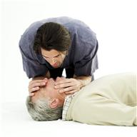
CHARACTERISTICS OF A PERFECT PROCESS?
Safe
Comfortable
Interesting
Challenging
Creative
Injury Free
Fatigue Free
Boredom Free
Have a sense of providing value
Have a sense of personal fulfillment & accomplishment

Slide 10
OPD PROCESS FLOW….
Patient searches for room number indicated in OP slip
Patient walks for 30 feet to locate the OP clinic
Patient waits in queue for 25 minutes.
On his turn, patient enters the clinic room
Doctor examines the patient physically (1 Min.)
Doctor checks the weight, pulse manually (stethoscope non-functional) and records on OP slip (2 Min.)
Doctor prescribes lab blood test on another slip (1 Min)
Patient leaves clinic room and moves to registration area for making payment for lab test.

Slide 11
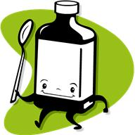
OPD PROCESS FLOW..(Contd…).
Patient moves to the Lab 30 feet away from Registration area
Patients waits to give Blood for the test
Patient waits for the test report (Test Process Delay)
Patient collects the test report and walks back to OP clinic
Patient waits for 20 Mins. in OP clinic area with test report & OP slip
On his turn, patient enters the clinic room
Doctor checks the lab report of the patient
Doctor prescribes medicines on OP slip (2 Min.)
Patient leaves clinic room

Slide 12
SEVEN WASTES IN A PROCESS…
Over processing
Errors
Inventory
Inappropriate Processing
Transportation
Waiting
Motion
Lab –sample processing
Errors in diagnosis, reports
Inventory-Medicines, stores
Processing-unnecessary steps
Transportation-unnecessary movement between two processes due to layout issues
Waiting between processes
Unnecessary movement of body parts due to searching, reaching out to higher level,

Slide 13
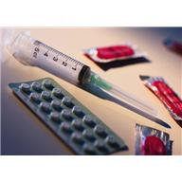
TYPICAL OPD LAYOUT
Dispensary
OP Clinic
Imaging
Registration & Billing
Laboratory

Slide 14
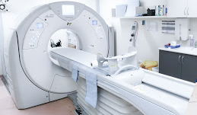
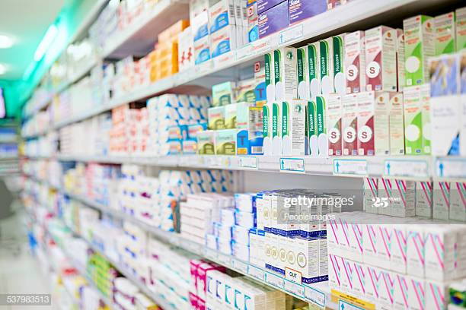
TYPICAL OPD MODIFIED LAYOUT…EFFECTIVE SPACE UTILISATION
HONEY-COMB MODEL
Registration & Billing
OP Clinic1
Laboratory
Imaging
Dispensary

Slide 15
THE NON-VALUE ADDING ACTIVITIES..
Regn.-NVA | OPD - NVA | Lab - NVA | Pharmacy-NVA
Search for Registration Counter | Patient searches for room number indicated in OP slip | After making payment, the Patient searches for laboratory | Patient reaches dispensary after walking about 30 feet
Patient waits in queue for 20 Mins. | Patient walks for 30 feet to locate the OP clinic | Walks about 60 feet & locates lab | The pharmacist checks for the medicines in the racks
 | Patient waits in queue for 25 minutes. | Patient waits for 1 hour | The pharmacist checks for the medicines in the racks
 | Patient waits for 20 Mins. in OP clinic area with test report & OP slip |  | Reaches out for a carton stored in the top rack (6 ft. high), pulls down the carton
 |  |  | Searches for the medicines for 8 min. to locate the medicines

Slide 16
STEPS FOR LEAN HCO…..1
1. SPECIFY “VALUE” FROM CUSTOMER PERSPECTIVE
PERCEIVED VALUE BY CUSTOMER:
Quick Service – No waiting
Reliable Service – Correct diagnosis, correct treatment
Low Cost
Pleasant experience (Environment) – Courtesy, Care, Concern

Slide 17
STEPS FOR LEAN HCO…..2
2. IDENTIFY “VALUE STREAM” FOR EACH TYPE OF SERVICE
OPD Service
EM Service
Surgical Service
Maternity care Service
Pediatric Service

Slide 18
TYPICAL VALUE STREAM FOR EMERGENCY (EM)…..3.
Value Stream | Starting Point | Intermediate | Ending Point
EM Department | Ambulance request | Triage | EM Discharge
 | Patient arrival | Triage | Shift to Procedure room
 |  |  | Start of treatment
 |  |  | Discharge

Slide 19
STEPS FOR LEAN HCO…..3.
3. MAKE THE “VALUE FLOW “ WITHOUT INTERRUPTIONS FROM BEGINNING TO END
Use Lean Tools to eliminate “waste” and facilitate Flow without interruptions
Value Stream Mapping
Kaizen
7 QC Tools
JIT & KANBAN
SMED
Standardization
Cellular Concept
5 S Technique
TPM

Slide 20
STEPS FOR LEAN HCO…..4…Contd…
4. LET THE CUSTOMER PULL VALUE FROM THE PROCESS
After removal of “waste”, only value added activities remain
The customer pays only for the value of service provided
The customer flow between the processes is improved
The customer gets faster services
This results in increased number of customers getting the services in a given time
Benefits the HCO as well

Slide 21
STEPS FOR LEAN HCO…..5…Contd…
5. PURSUE PERFECTION – CONTINUAL IMPROVEMENT
Continue identifying the “waste” and improving up on the processes
Improve the processes for further reduction in the process time
The customer gets improved services faster
This sets in an improvement trend across the HCO
Newer value added services could be introduced by the HCO for the benefit of the customer

Slide 22
APPROACH TO LEAN PROJECT
After initial VS is selected, it should be defined and scoped (Targets of Metrics to be achieved)
Focus on improving performance rather than implementing Lean Methods – which means focus on “Metrics”
Define the problem with an appropriate “Problem Statement”
Standardize processes
Include in the charter a statement about how the Project aligns with the hospital’s strategic plan / Annual Plan
Define the key milestones & the expected timelines for the Project along with key responsible persons
Have a dedicated full time process improvement team (cross-functional team) with nurse, pharmacist, persons with appropriate hospital exposure, Project Leader and a Coach (Consultant)
10 – 20% of the challenge is the implementation of technical tools & methods
80 – 90% of Lean implementation challenge relates to people & acceptance of change

Slide 23
ACKNOWLEDGEMENT:
Prof. Shigeo Shingo, Author of “ A study of Toyota Production System from IE point of view, Productivity Press, 1989
2) Mr. Akhilesh N. Singh, Director, Lean Solutions-Business Excellence Consulting
3) Mr. Mark Graben, Lean Healthcare Consultant, Author of Lean Hospitals, CRC Press, NY, 2012

Slide 24
THANK YOU

